Slide 1
Intelligent-Irrigation System
TEAM Water-IT

Slide 2
Points To Be Covered
INTRODUCTION
OBJECTIVE
SYSTEM DESIGN
ADVANTAGES
FURTHER SCOPES
CONCLUSION

Slide 3
INTRODUCTION
The aim of this project was to create an open source, automatic irrigation system, to give anyone the ability to automate irrigation and reconstruct the life of the farmers.
The system uses low-power LoPy devices to collect local data about the user's environment (humidity, temperature, sunlight intensity), transmit that data to the cloud for processing, process the data with the computational power of a cloud-hosted solution (potentially incorporating historic data, weather forecasts, and presenting the data to the user in a web app / phone app format), and control any given irrigation valves automatically based on the need.

Slide 4
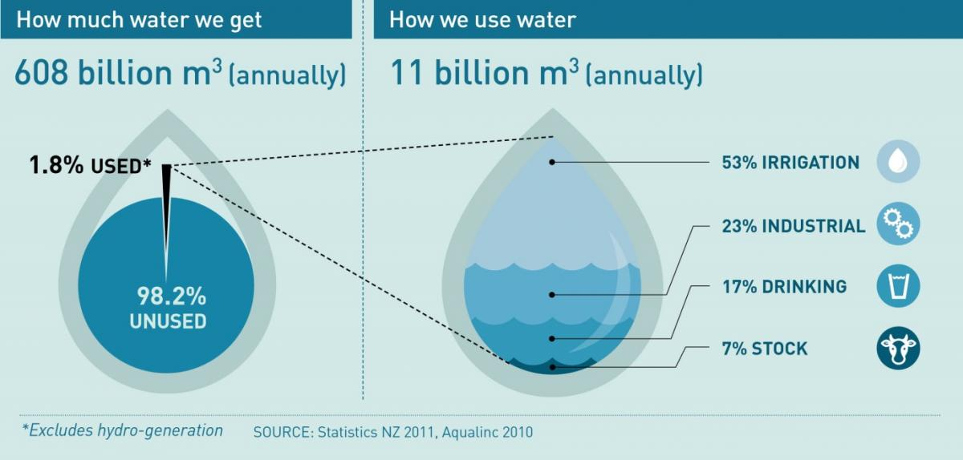
OBJECTIVE
LoPy parts: low-power components using LoRa for communication, to make power draw minimal and maximize reach - these can be placed pretty much anywhere around the properly the user decides, with the exception of the controller, which will draw more power thanks to the WiFi communication with the cloud, and should be somewhere inside the house, connected to an electric outlet.

Slide 5
SYSTEM DESIGN
Parts of the system:
LoPy controller: listens for data from sensors, transmits commands to actuators, communicates with the cloud
LoPy sensor: uses various sensors (currently hooked up to an Arduino) to sense data about the environment; communicates over LoRa
LoPy actuator: controls valves or other irrigation-relevant equipment. Receives data over LoRa.
Cloud server: communicates with the LoPy controller, processes data and decides when and what actuators to turn on.

Slide 6
ADVANTAGES
Installing automated irrigation systems in farms is an effective way to reduce your water costs, prevent uneven watering and keep your lawn healthier. Additionally, installing an efficient irrigation system can also increase the value of your property and save you time.These are the top 3 problems solved by installing the auto-irrigation system:
Lower the water consumption
Prevents Uneven Watering
A healthy farm
The right automated irrigation system can help increase the value of the crops, as well as save the farmer’s time.

Slide 7
FURTHER SCOPES
The auto-irrigation system can be further used by the government to be sold on retail which will in turn generate revenue. This revenue can be used for the benefits of the farmers by providing them the earned revenue in forms of kind or reforms.
We can extend this system to the defence forces. This kind of low-power mesh of sensors and actuators could be extended with presence detection systems, maybe hooked up to the main home security system, and could remotely turn on hoses which would spray an intruder with gasoline, then produce a spark close to them.

Slide 8
CONCLUSION
The auto-irrigation system can be used for the benefits of farmers which are suffering from a lot and a bunch of water excess in soil will not be helping them. This presented proposal and project to you is a way to modernize the agriculture industries at mass scale with the efficient use of water as well as money. Using the auto-irrigation, an individual, a group or the whole country can save manpower, water to ultimately increase the profit and thereby the lifestyle of the poor.

Slide 9
THANK YOU !!
WATER IS PRECIOUS SAVE WATER

